Slide 1

HOTEL MANAGEMENT SYSTEM
A Presentation By Group-5
B Sushma (AM.EN.U4CSE20015) T Samhitha(AM.EN.U4CSE20072)
K Jahnavi (AM.EN.U4CSE20031) V Harshini (AM.EN.U4CSE20075)

Slide 2

ABSTARCT:-
The main aim of Hotel Management project is to manage hotel rooms and services. We aim to demonstrate the use of create, read, update and delete MySQL operations through this project. In this project the details are maintained like customer details & reservation details & Booking details and billing details The reservation process of reserving rooms for the customers and canceling the reserved rooms booking the rooms & vacating the rooms & the restaurant management & billing process & etc all are computerized and the management is done without any difficulty.The reports can be viewed completely and the head of the management daily or weekly or monthly can review it.
Using the hotel management system the following activities can be performed.
Room Service
Check In
Check Out
Food Service

Slide 3
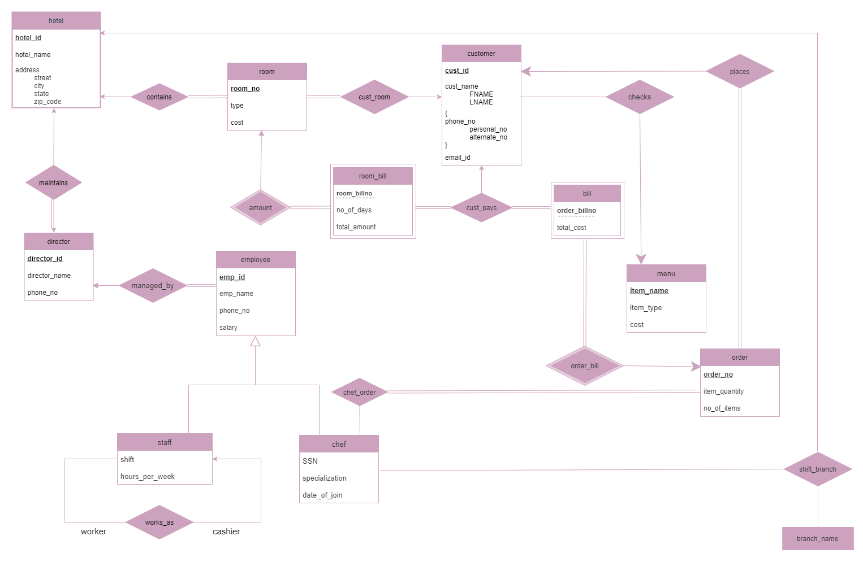

Entity Relationship
Diagram:-
ER

Slide 4
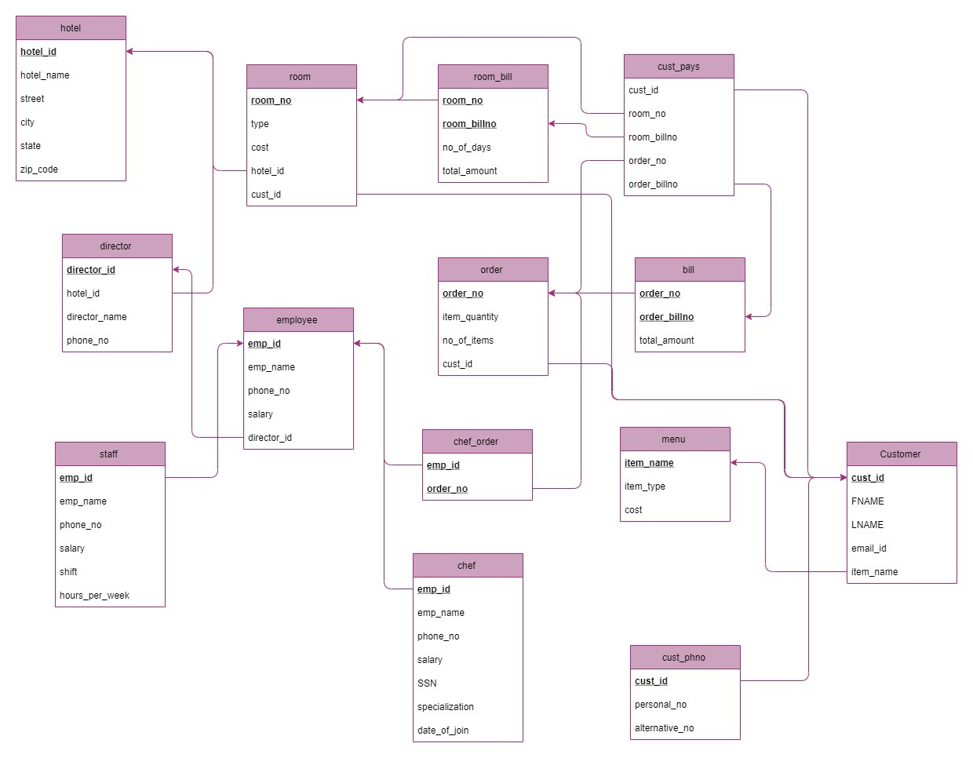
Schema Diagram:

Slide 5
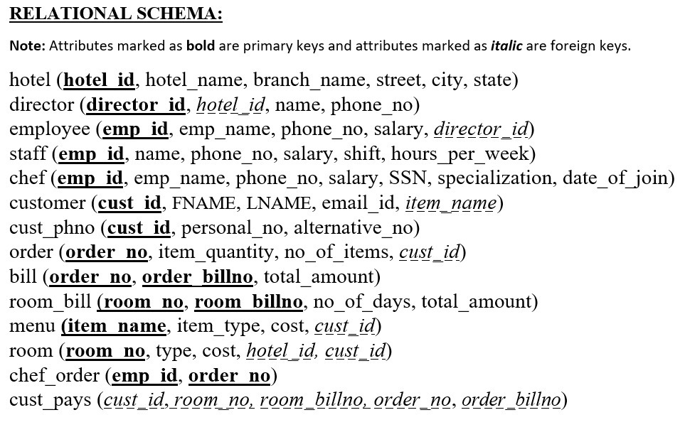
Relational
Schema:-

Slide 6
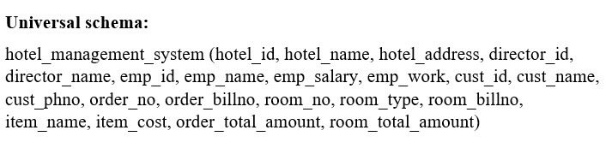
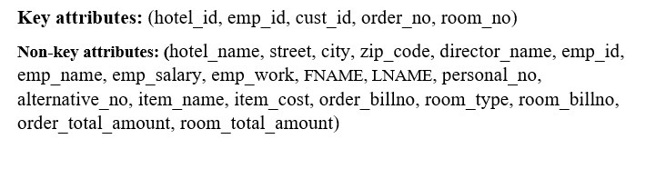


Slide 7
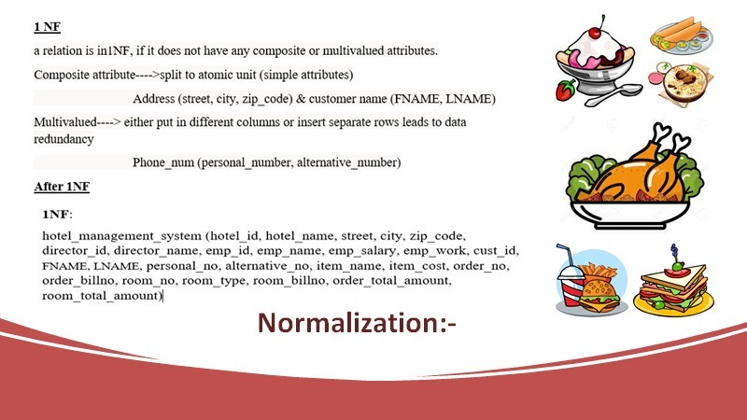
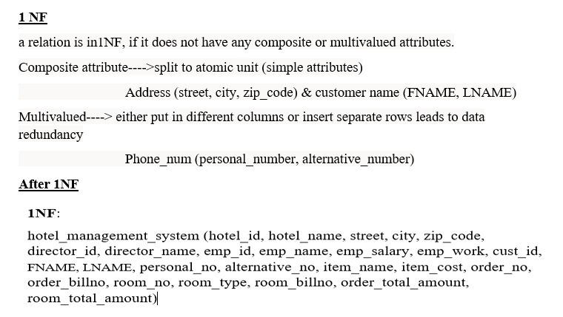
NORMALISATION:-

Slide 8
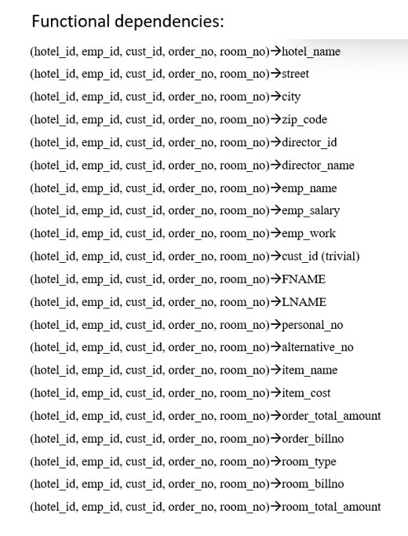


Slide 9
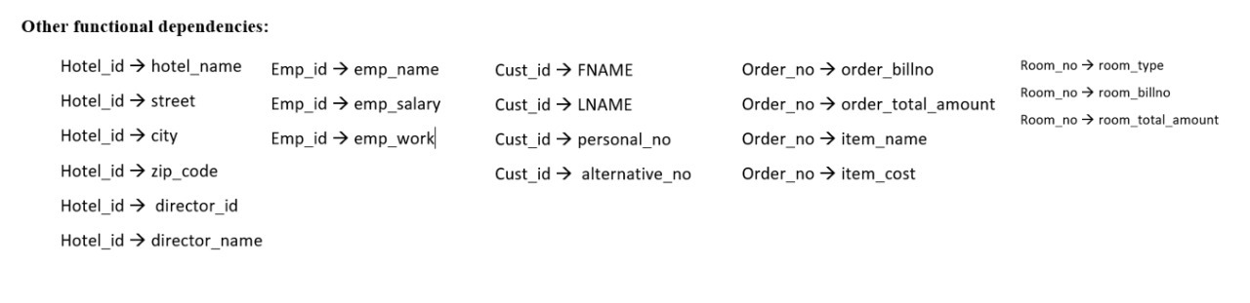



Slide 10
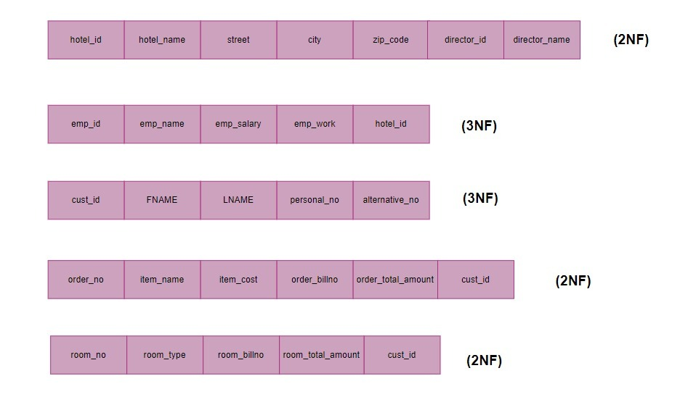

2NF:-

Slide 11
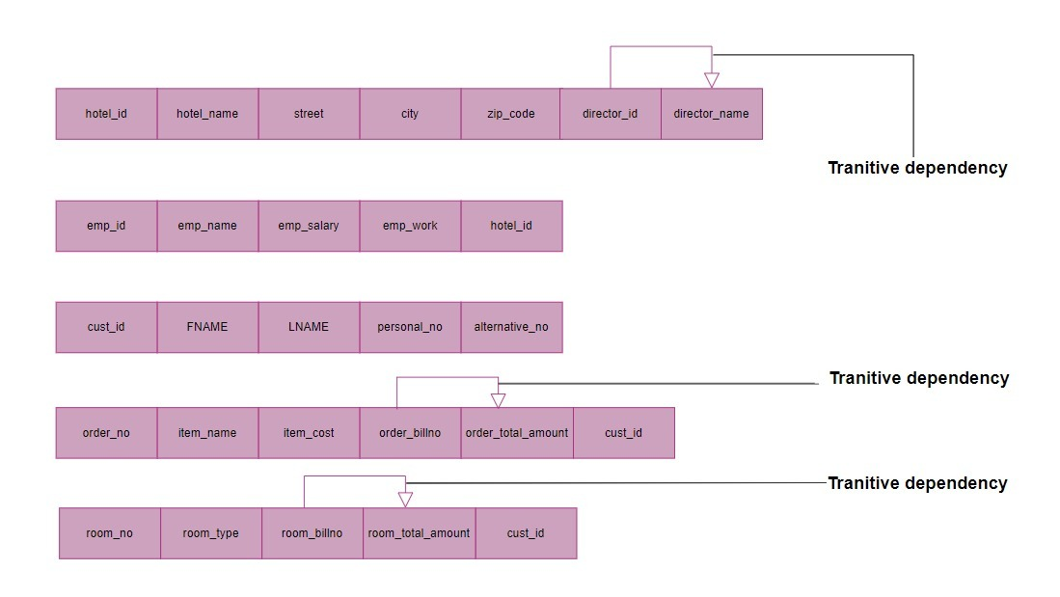




3NF:-
Transitive dependency
Transitive dependency
Transitive dependency

Slide 12
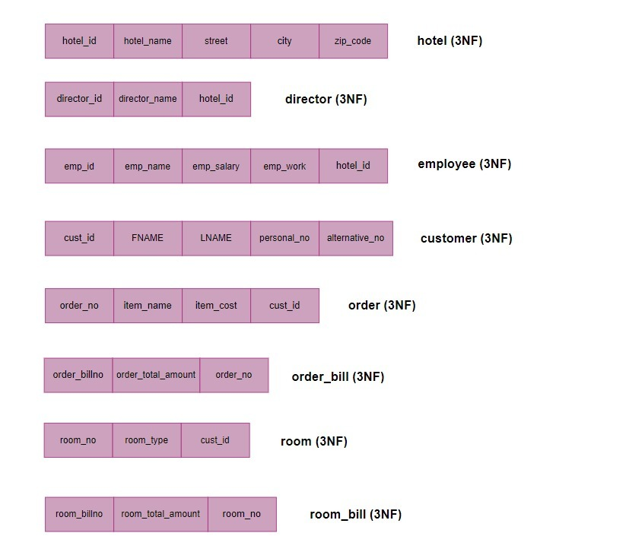


Slide 13
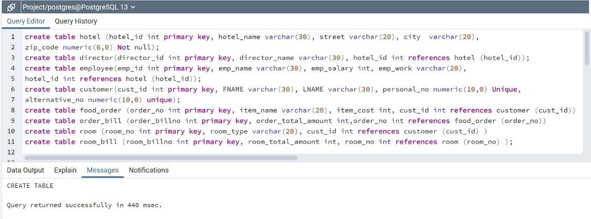
DDL Statements:-

Slide 14
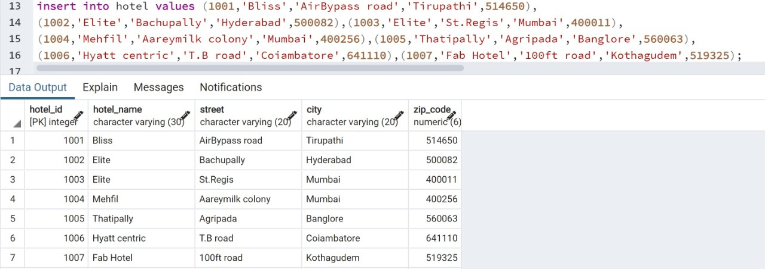
Queries & Results :-
Hotel Table:-

Slide 15
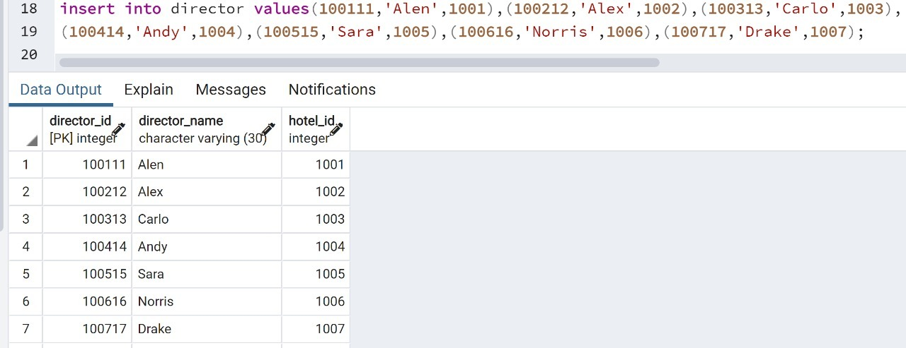

Director Table:-

Slide 16
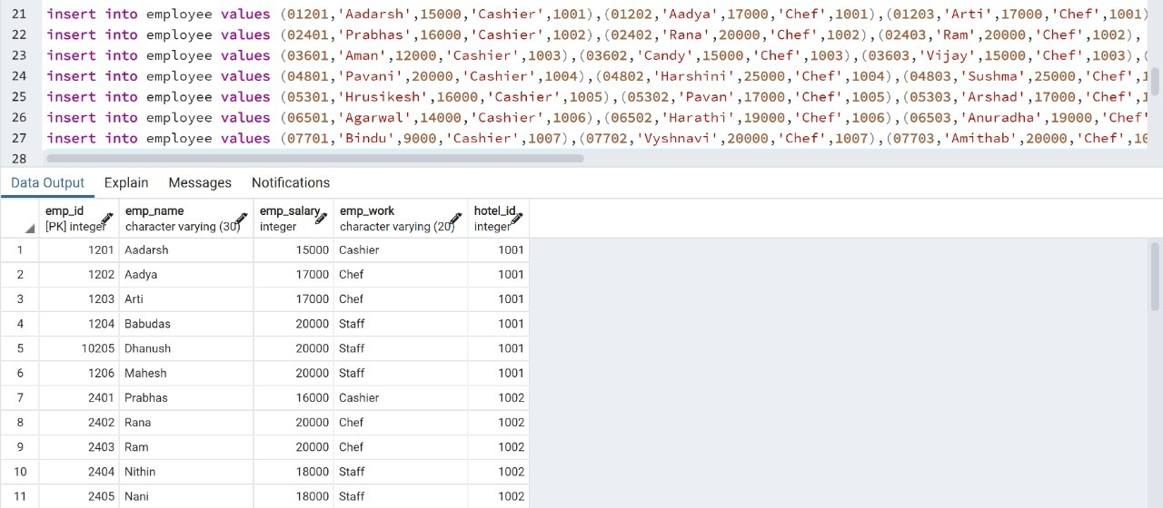
Employee Table:-

Slide 17
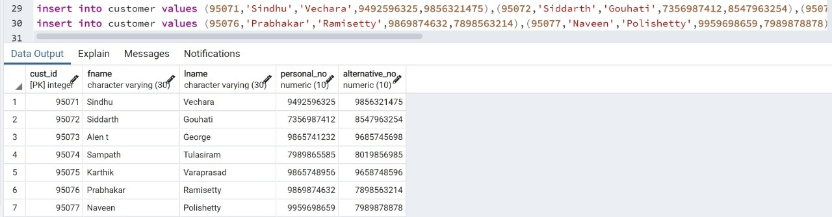
Customer Table:-

Slide 18
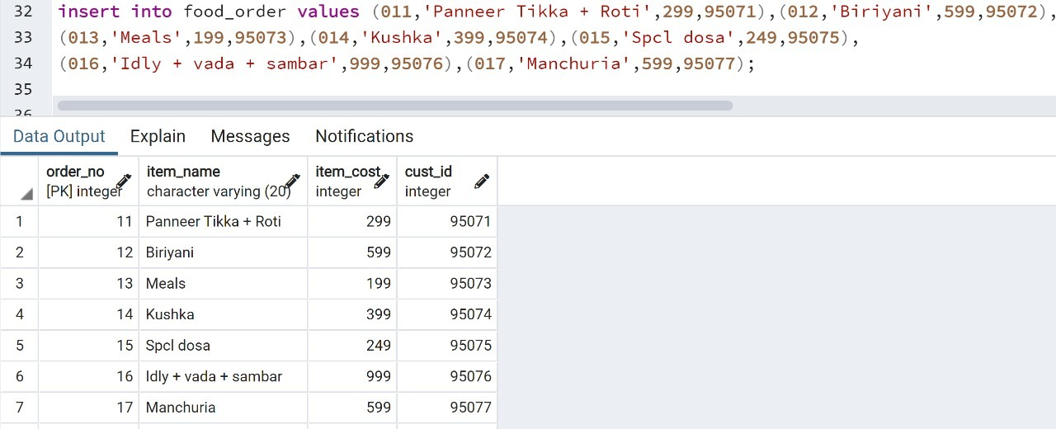
Food_Order Table:-

Slide 19
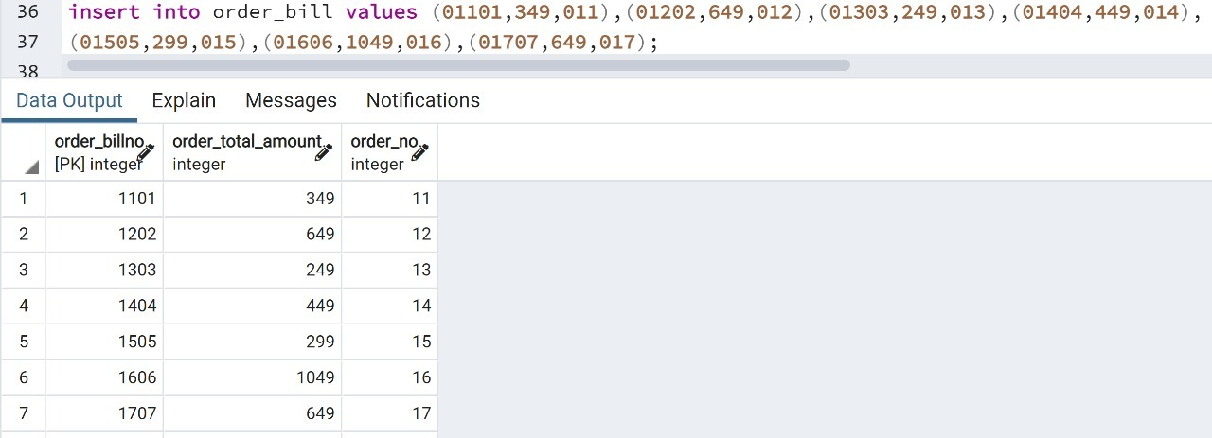
Order_bill Table:-

Slide 20
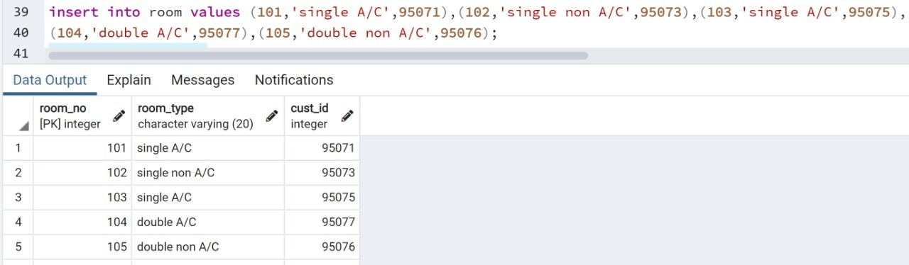
Room Table:-

Slide 21
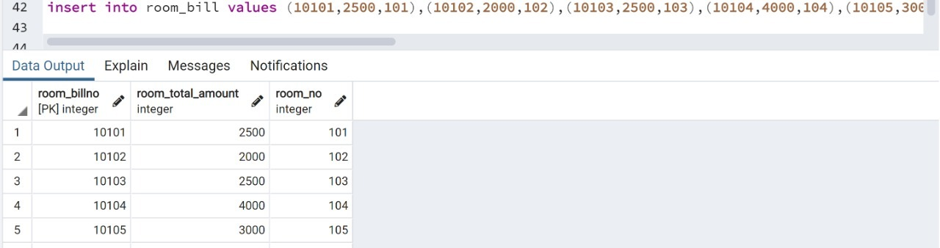
Room_bill Table:-

Slide 22
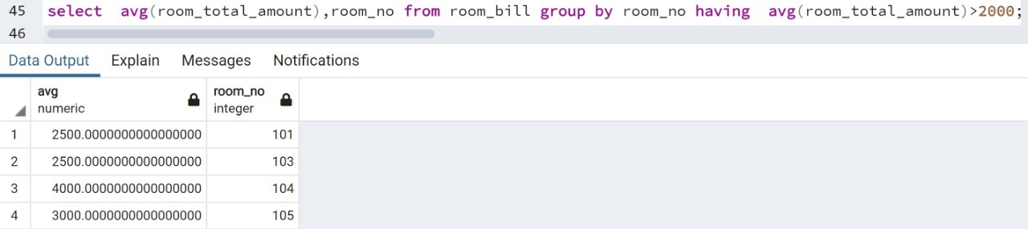
Queries
i. Aggregate Functions , Group By ……Having:-

Slide 23
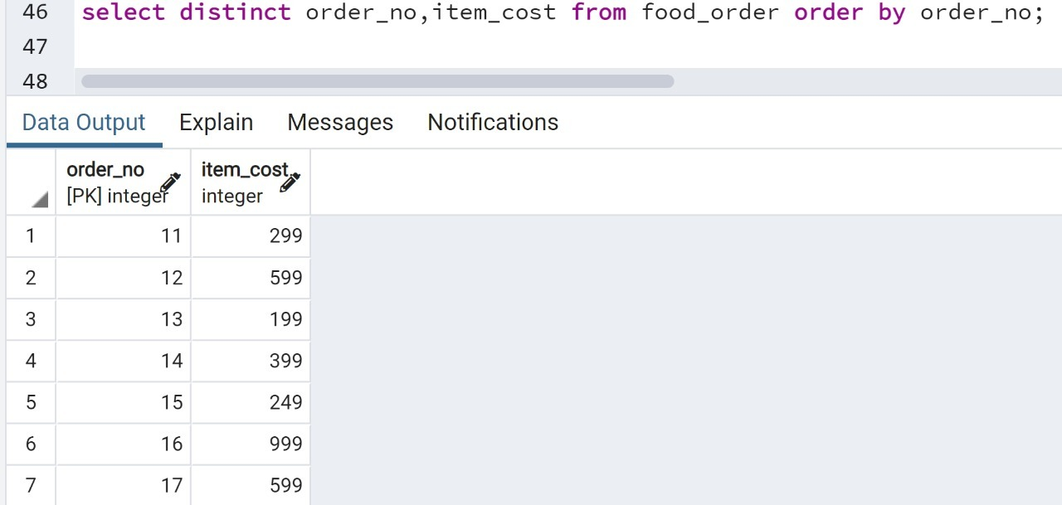
ii. Order_by

Slide 24
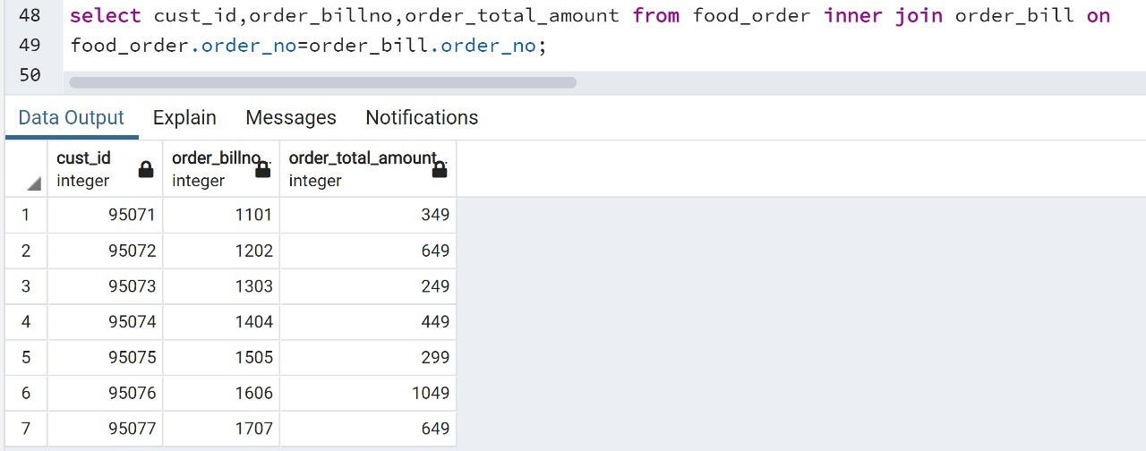
iii. Inner Join :-

Slide 25
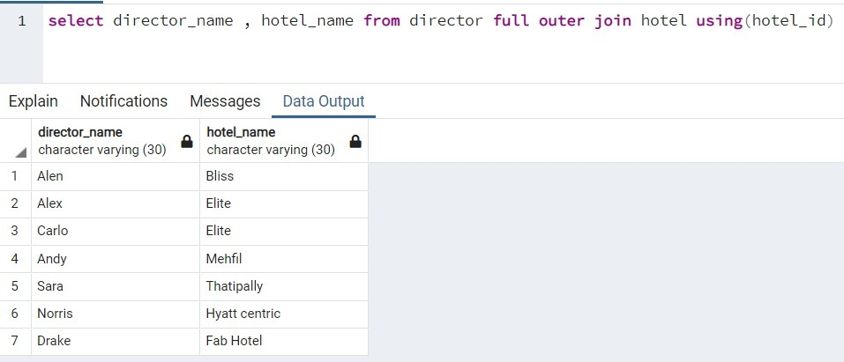
Outer Join:-

Slide 26
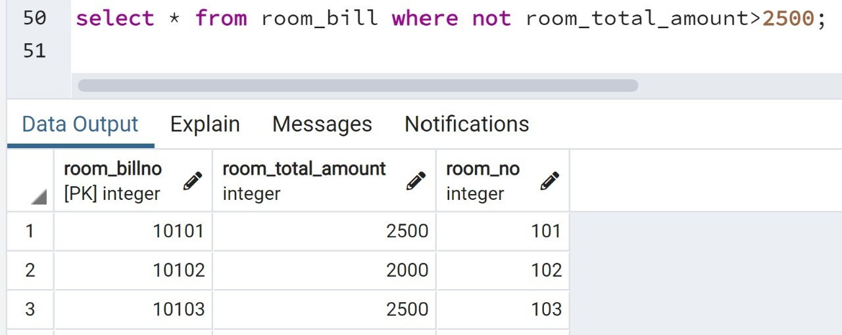
iv. Query having Boolean operators (Not ):-

Slide 27
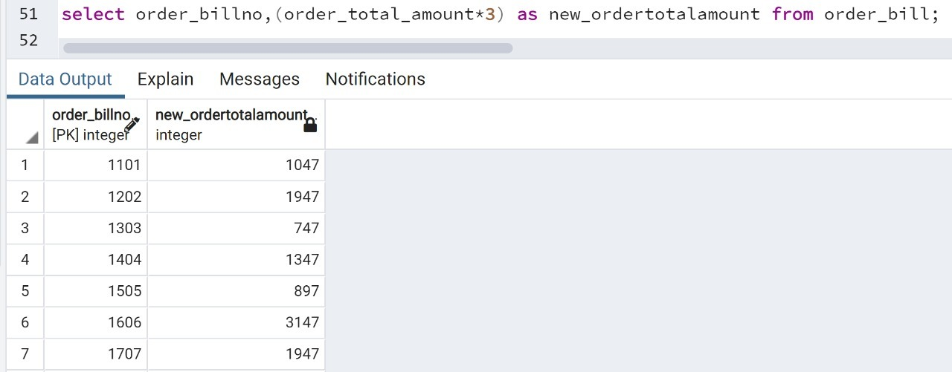
V. Query having Arithmetic operators:-

Slide 28
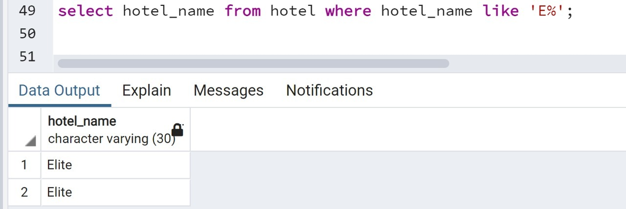
Vi . A search Query using String operators :-

Slide 29
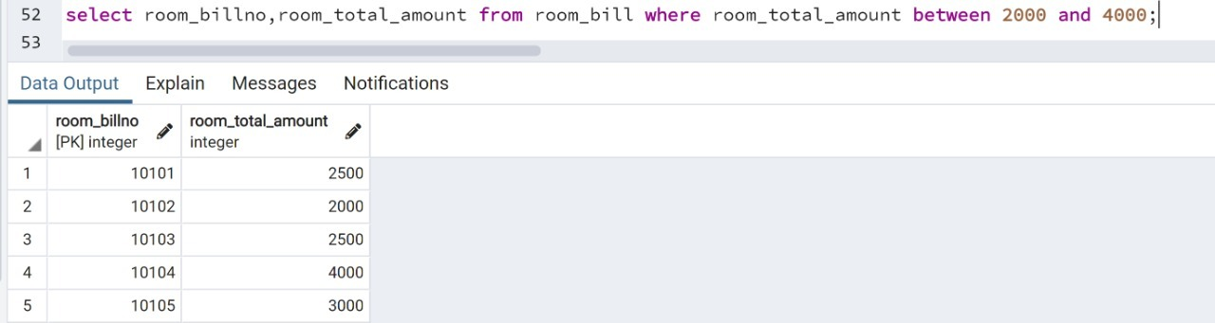
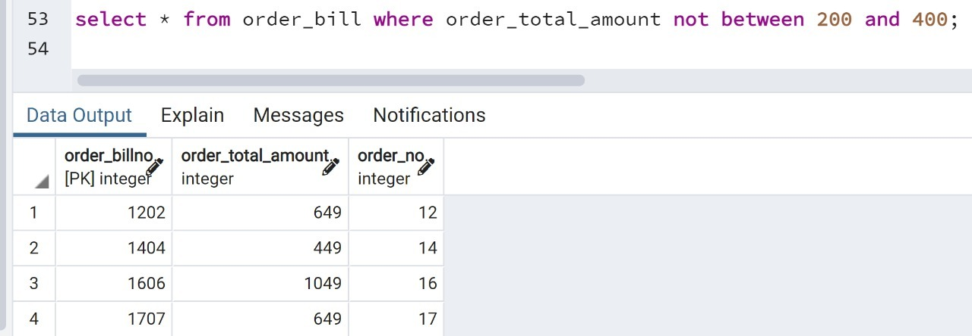
Viii – Between , In, Not Between , Not In:-
Between:-
Not Between:-

Slide 30
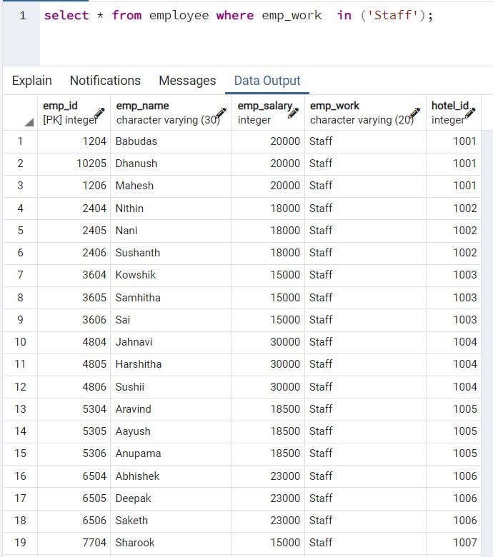
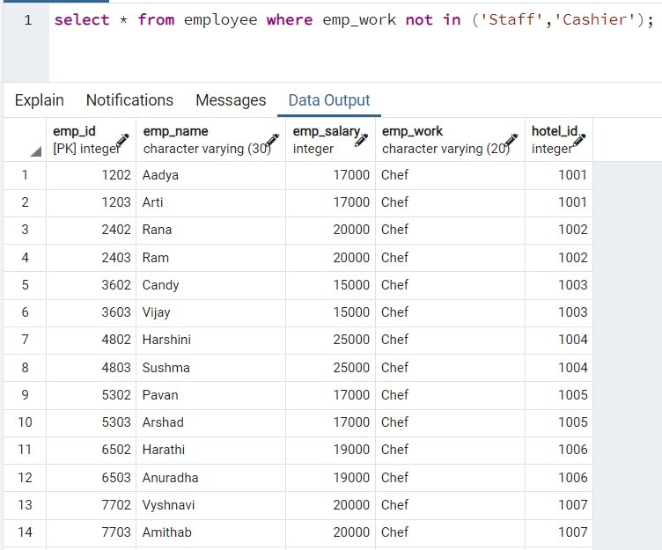
In :-
Not In :-

Slide 31
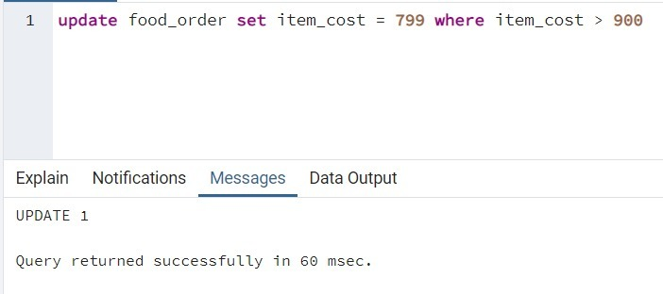
ix set operations:-

Slide 32
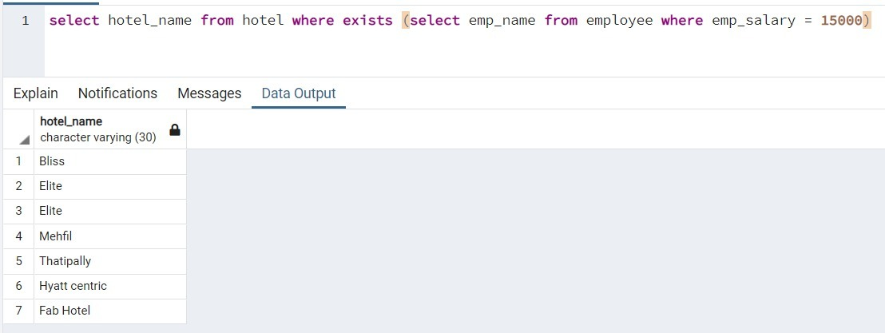
subqueries:-
(using EXISTS / NOT EXISTS , ANY,ALL)
EXISTS:-

Slide 33
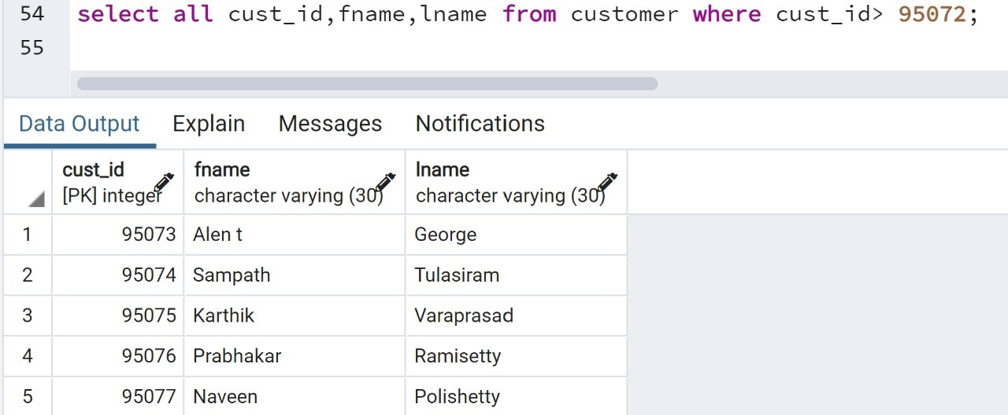
ANY:-
All:-

Slide 34

THANK YOU :)

